Slide 1
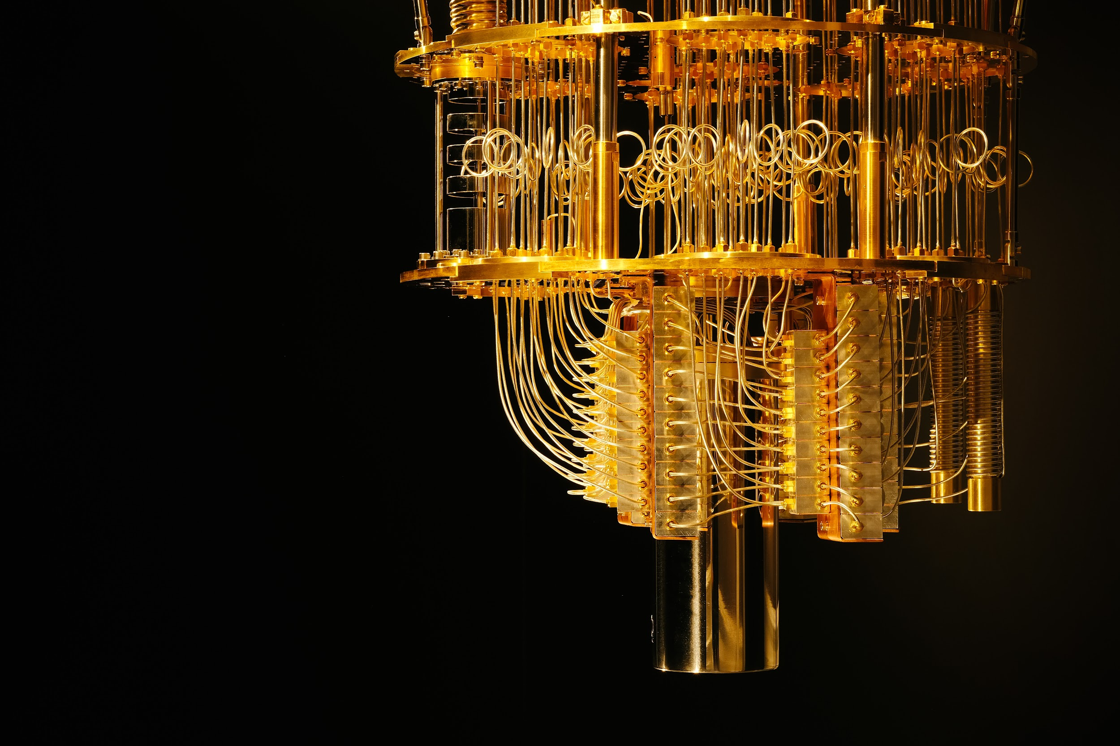
Quantum Computing

Slide 2
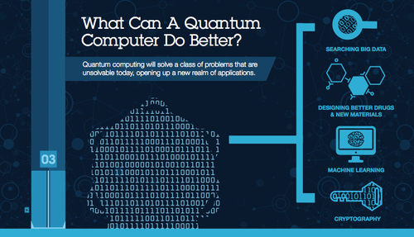

Slide 3
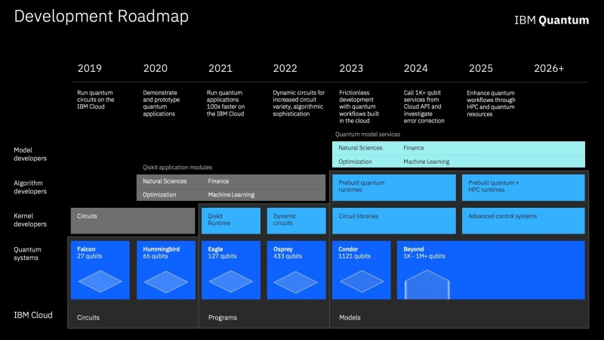

Slide 4
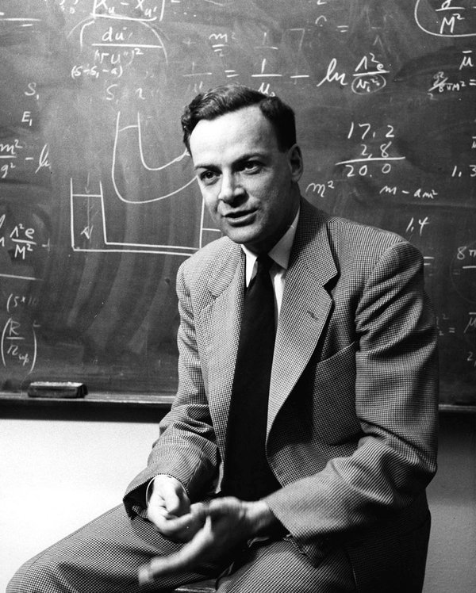
“I think I can safely say that nobody really understands quantum mechanics”
-Richard Feynman, 1964, MIT

Slide 5
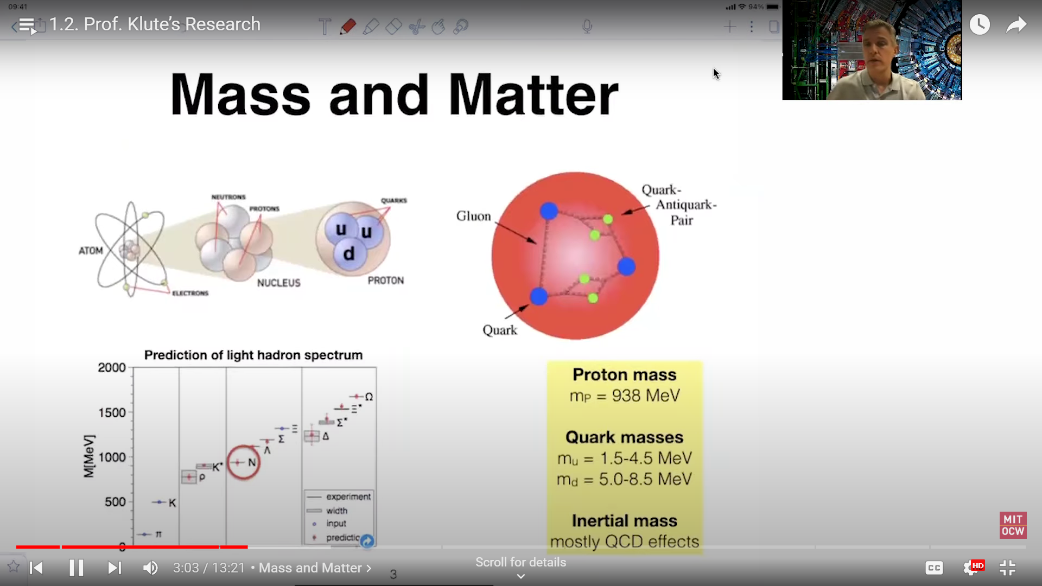
Quantum Object
Quantum: Smallest discrete unit of a physical property.
Quantum mechanics: Subatomic particle movements

Slide 6
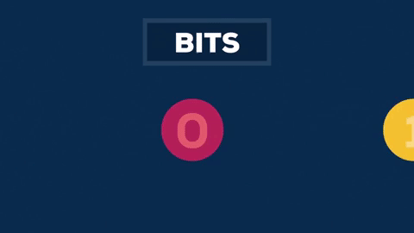

Slide 7
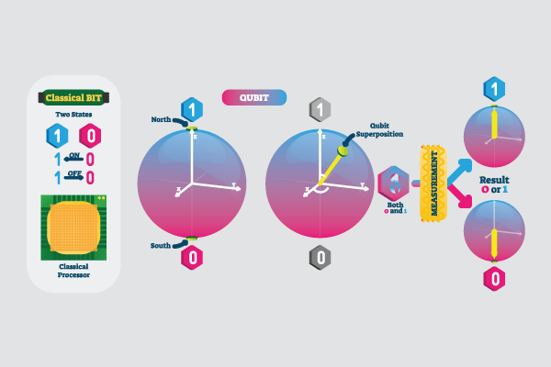

Slide 8
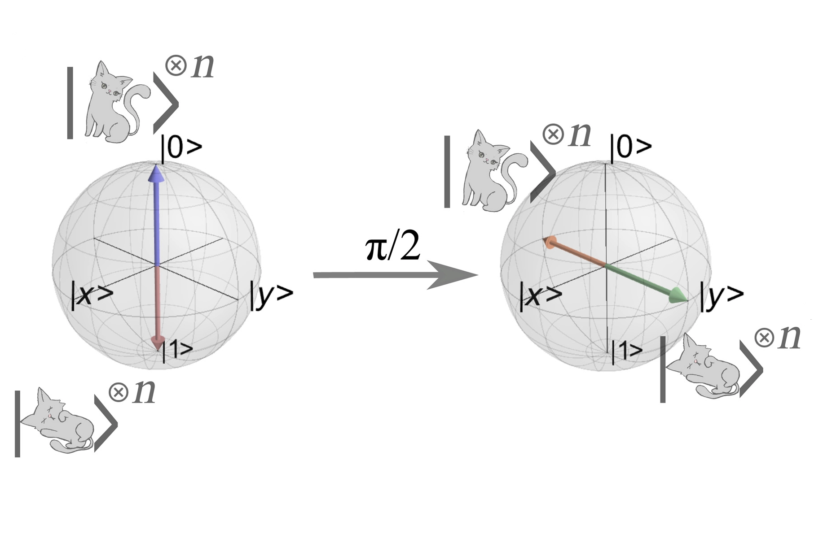
Qubits and Superposition

Slide 9


Slide 10
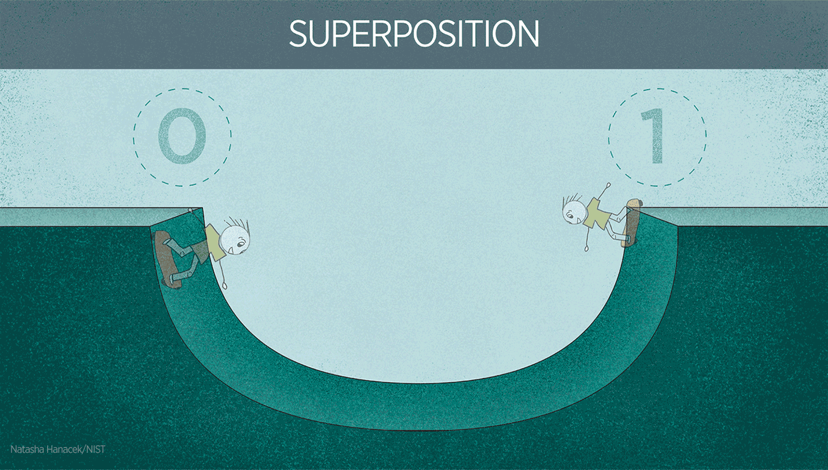

Slide 11
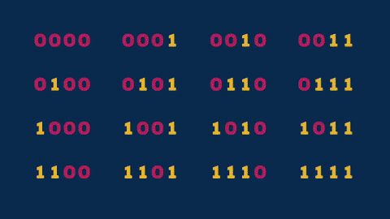

Slide 12
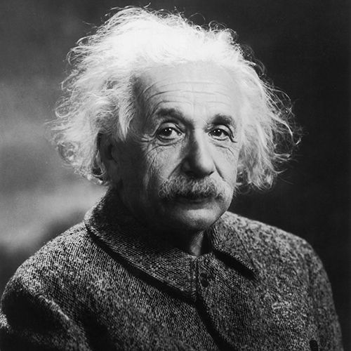
Quantum Entanglement
The 2022 Nobel Prize in physics recognized three scientists who made groundbreaking contributions in understanding one of the most mysterious of all natural phenomena: Quantum Entanglement.
-Alan, John, Anton
When two particles are entangled, the state of one is tied to the state of the other.
spooky action at a distance
-Albert Einstein

Slide 13
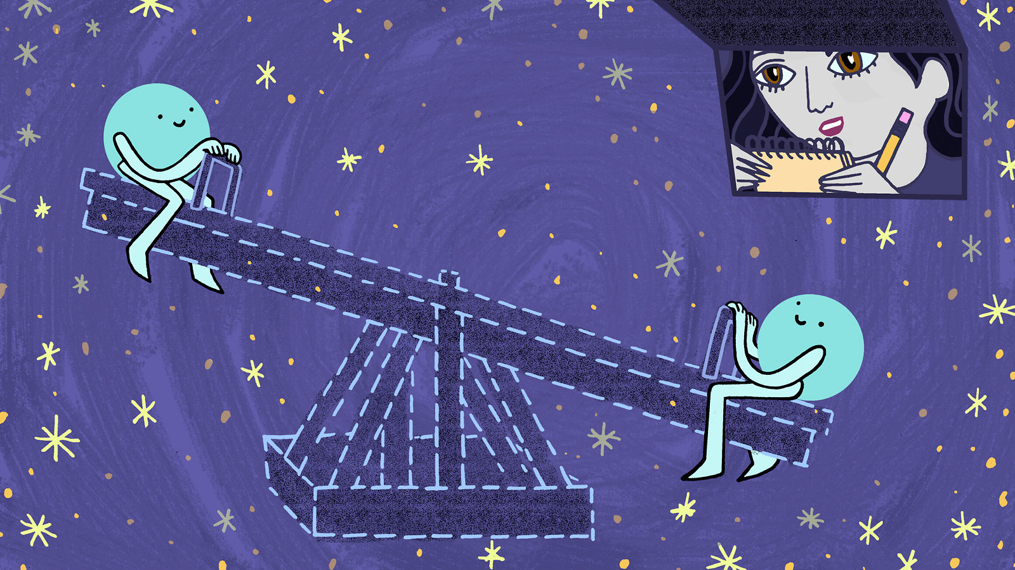

Slide 14
Cloud Services for Quantum Computing
IBM - Qiskit
Google - Cirq
Microsoft - Q#
AWS - Braket

Slide 15
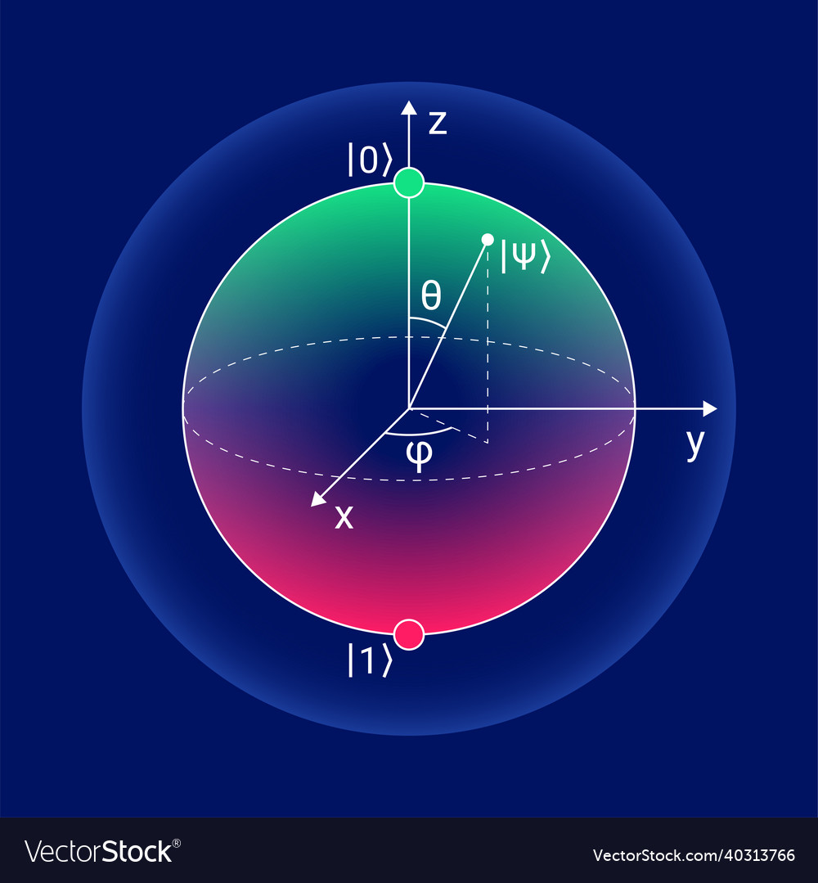

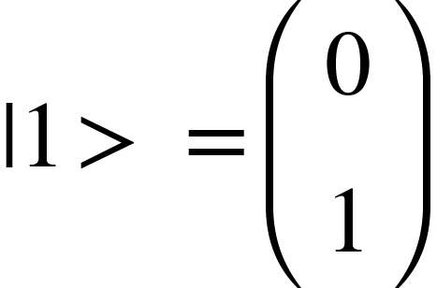
How to represent a Qubit..?
A qubit is represented as a complex vector of size 2.
State |0> = and State
In quantum mechanics “ bra-ket “ or “Dirac” notation is used to denote quantum states.
This notation uses angle brackets “< “and” >” end a vertical bar “|” to construct “bras and kets”.

Slide 16
Representation of Qubits-Superposition
Qubit can also present in superposition of states.
That is in a quantum system,if a particle can be in a state |0> and |1>.Then it can also be in a state α|0>+β|1>.
Here α,β are complex numbers.
This vector is normalized. That is |α|²+ |β|²= 1.
modulus of α and β : | α |² = (α )(α )* |β|²=(β)(β)*
Here * denotes the complex conjugate.

Slide 17
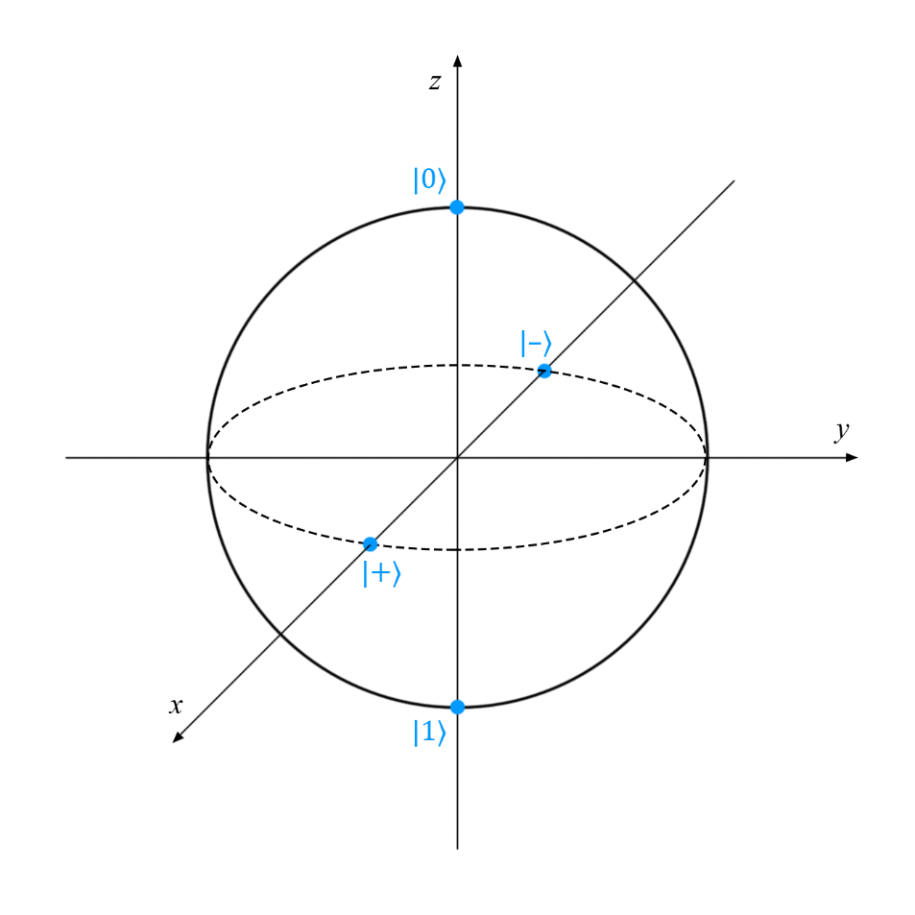
The Bloch’s Sphere
Bloch’s sphere is a geometric representation of quantum states, where different points in the surface of the unit radius sphere represent various quantum states.
A qubit can be represented in 3D space as a vector of unit length connecting points in the surface of Bloch’s sphere
|+> =1⁄√2 (|0> +|1>)
|-> =1⁄√2 (|0≻-|1>)
|+> and |-> are called Hadamard’s basis.

Slide 18
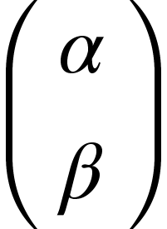
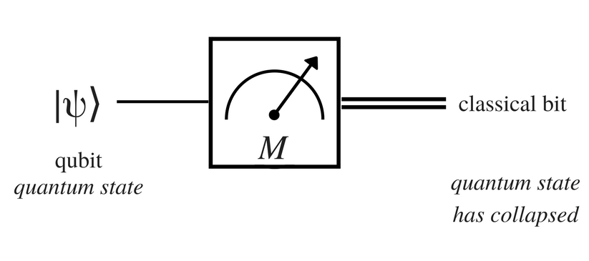
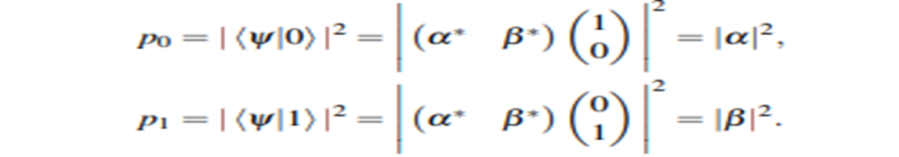
How to Measure a Qubit..?
When we try to observe the superposition state it collapses to one of the values and it will remain in that state for the rest of the time.
The collapse of superposition state in in-deterministic and completely random.
If |ψ> = α|0> + β|1> = Then the probability of |ψ> occurring in state |0> is |α|² and probability of |ψ> occurring in state |1> is |β|² .

Slide 19
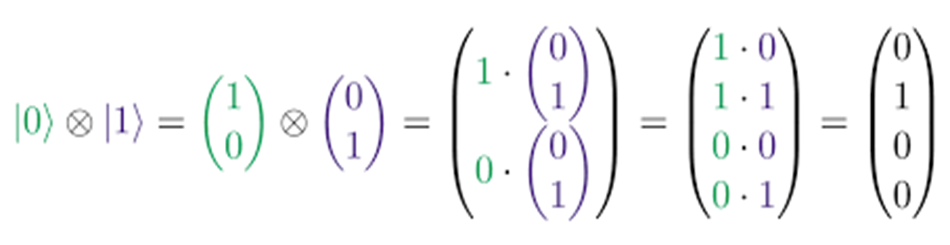
Multiple Qubits..
State of Multi-Qubit system obtained by taking tensor product of individual qubit state.

Slide 20
Quantum Gates..
Single Qubit Quantum Gates
It is an unitary operations.(u^T u= I)
Any single qubit quantum gate is given by an unitary transformation
U=e^iα Rn (θ)
Here R is the rotational operator about an arbitrary direction and n is the unit vector.
Pauli Gates
The Pauli-X gate is a single-qubit rotation through π radians around the x-axis. It is work like as a NOT gate in classical computer. It convert state |0>to |1> and |1> to |0>. It is also called as bit-flip gate.
Pauli x gate outer product form : X=|0><1|+|1><0|

Slide 21
Pauli Y Gate
The Pauli Y gate maps |0>to i|1> and |1>to -i|0> ."The Pauli-Y gate is a single-qubit rotation through π radians around the y-axis."
Pauli Y Gate outer product form : Y= -i|0><1|+i|1><0|
Pauli Z Gate
The Z-gate is a unitary gate that acts on only one qubit. Specifically it maps 1 to -1 and leaves 0 unchanged. It does this by rotating around the Z axis of the qubit by π radians (180 degrees). By doing this it flips the phase of the qubit. It is also called Phase flip gate.
Pauli Z gate outer product form : Z =|0><0|-|1><1|.
Pauli X gate is not an universal NOT gate.It only operate on single qubit pure state. It is not for the linear combinations.

Slide 22

Hadamard Gate
It create superposition of basis gate.
Outer product form of
hadamard gate= 1/(√2) (|0><0|+|0><1|+|1><0|-|1><1|)
|+> and |-> are called Hadamard basis.
Hadamard gate is also called as square root of NOT gate(√NOT).Because it produce states that are lie in the halfway between 0 and 1.

Slide 23
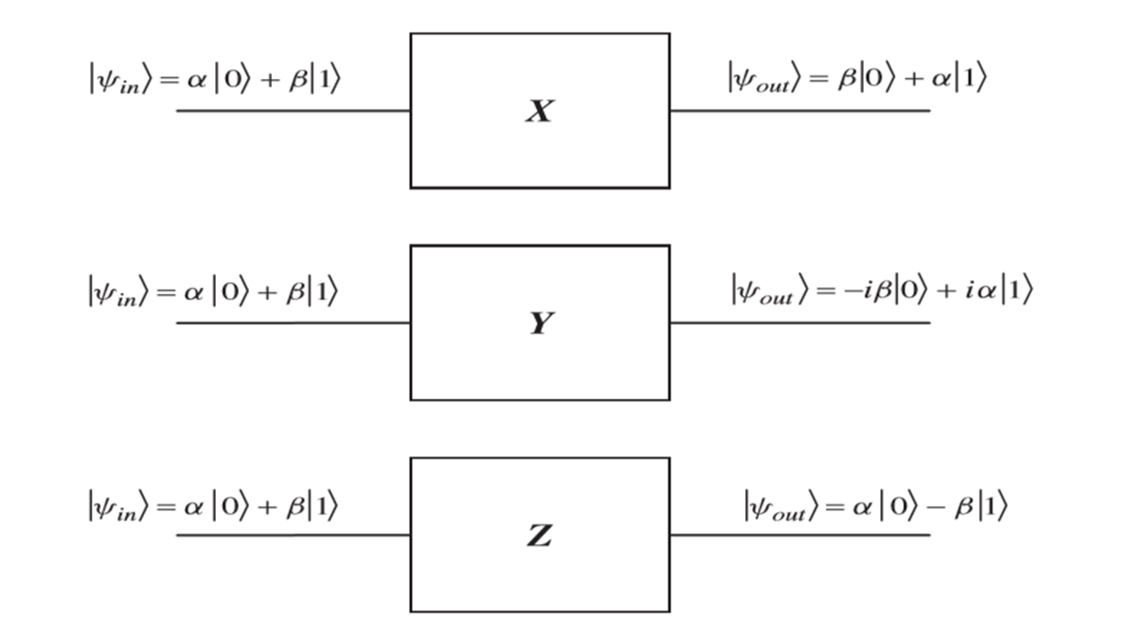
Basic Quantum Circuit…
The Circuit diagram representations of the Pauli operators and their actions on a single arbitrary qubit .

Slide 24
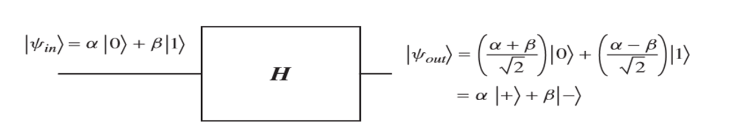
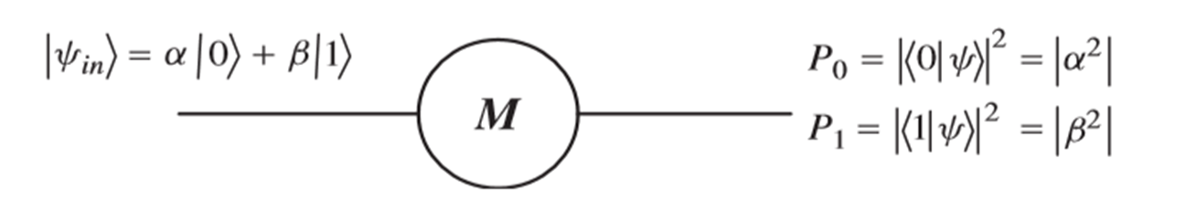
The Hadamard gate circuit
The measurement Circuit

Slide 25
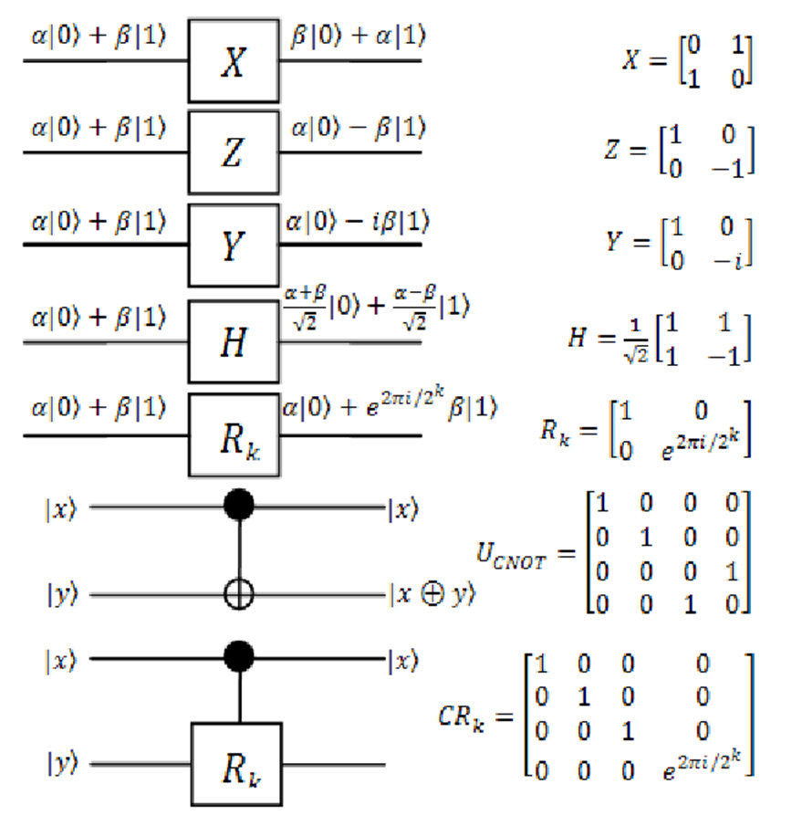
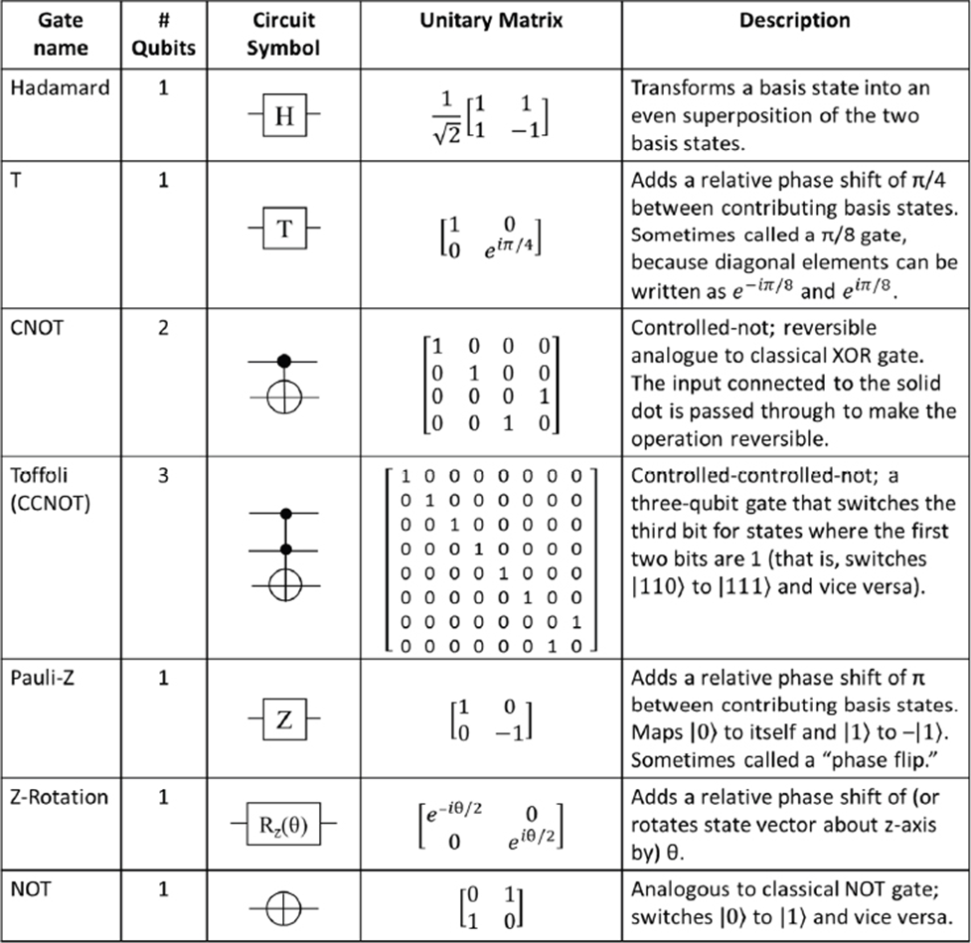

Slide 26
Quantum Cryptography…
Quantum Cryptography is based on the phenomena of quantum physics which allows secure data transmission between sender and receiver.
“Quantum Cryptography is the art and science of exploiting quantum mechanical effects in order to perform cryptographic tasks.”
Why Quantum Cryptography…?
Basic working principle of classical cryptographic algorithms developed around mathematical models.
The security of classical cryptography is based on the high complexity of the mathematical problem for the instance factorization of large number.
Quantum computers can make these classical encryption strategies unsafe.
Quantum cryptography establishes secure communication by providing security based on fundamental laws of physics instead of mathematical algorithms or computing technologies used today.
Quantum cryptography is a method of encryption that uses the naturally occurring properties of quantum mechanics to secure and transmit data in a way that cannot be hacked.
The two groundbreaking algorithms challenging the existence of current cryptographic schemes are Shor’s algorithm and Grover’s algorithm.

Slide 27
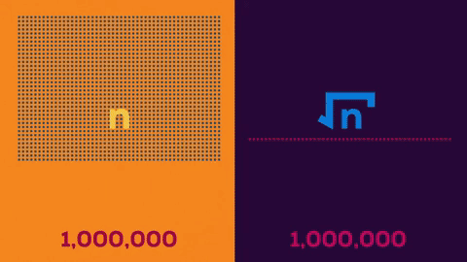

Slide 28
Principles of Quantum Mechanics
Quantum Cryptography is a latest and advanced branch of cryptography its basis lays in the two beliefs of quantum technicalities : Heisenberg's uncertainty principle and principles of photon polarization.
Heisenberg’s Uncertainty principle: It states that certain pairs of physical properties are related and complementary in the sense measuring one property, prevent simultaneously knowing of other property and destroying it.
Principle of Photon Polarization: An individual photon can be described as having right or left circular polarization, or a superposition of the two.
No Cloning Theorem: It is impossible to create an independent and identical copy of an arbitrary unknown quantum state.

Slide 29
Quantum Key Distribution…
This scheme allows the one to distribute the sequence of random bits whose randomness and privacy are guaranteed by the laws and concept of quantum mechanics. These sequences can be used as secret keys and also surety about the conﬁdentiality data transfer.
There have some practical limitations of quantum key distribution.
QKD requires an optical environment for transmission like optical ﬁber.
The range of QKD is limited about 60 miles or 100 kms.
Quantum key is only used to produce and distribute key only not for message and any type of data.

Slide 30
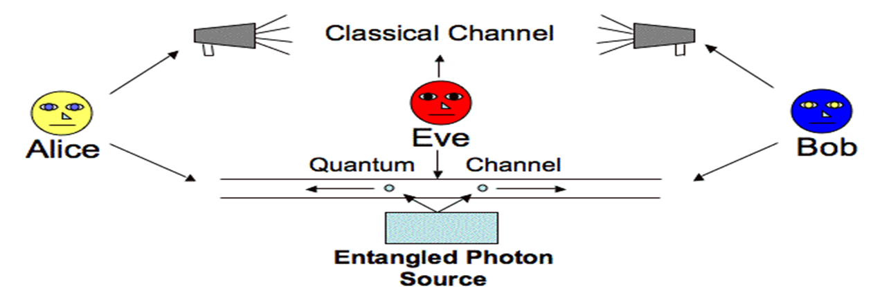
BB84 Protocol(Bennett and Brassard)
In this protocol, The pair of states are used and these pair of states are orthogonal to each other.
In it Alice chooses a random bit like 0 or 1 then set with the basis, basis are two types one is rectilinear and diagonal basis.
Alice sends photon in that state to Bob .
Bob is also randomly go with basis. If bit have same basis correspondingly at both ends then successfully shared key.

Slide 31
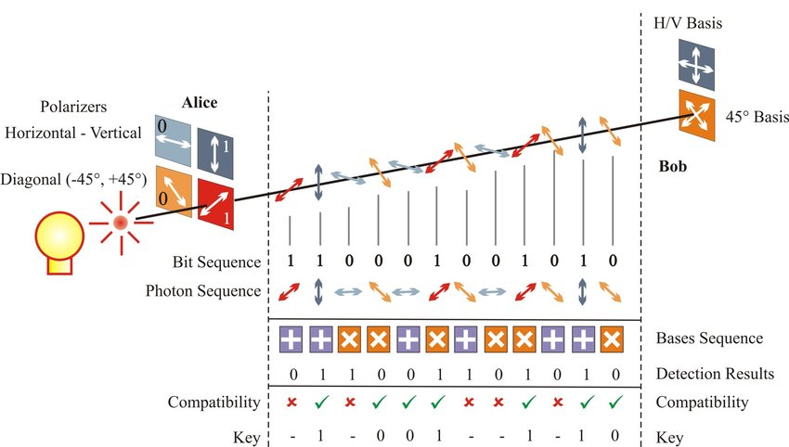

Slide 32
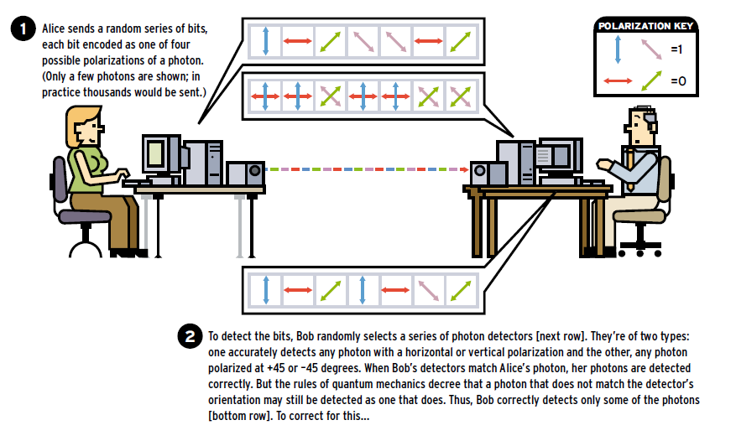

Slide 33
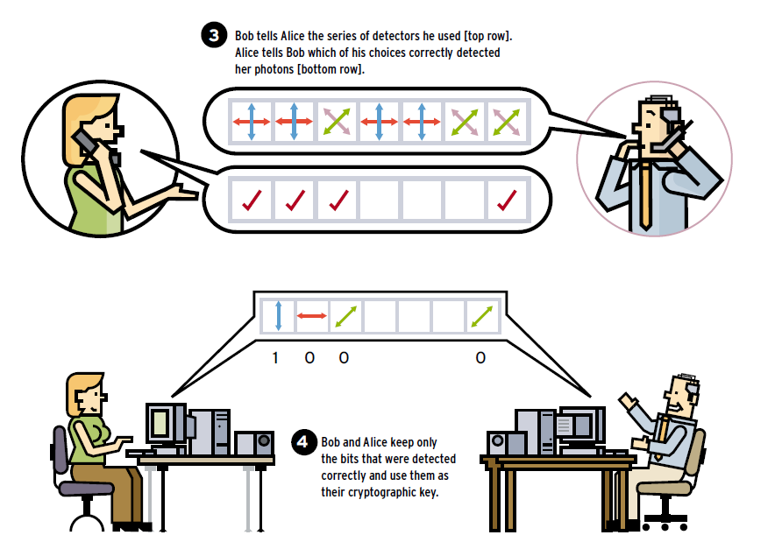

Slide 34
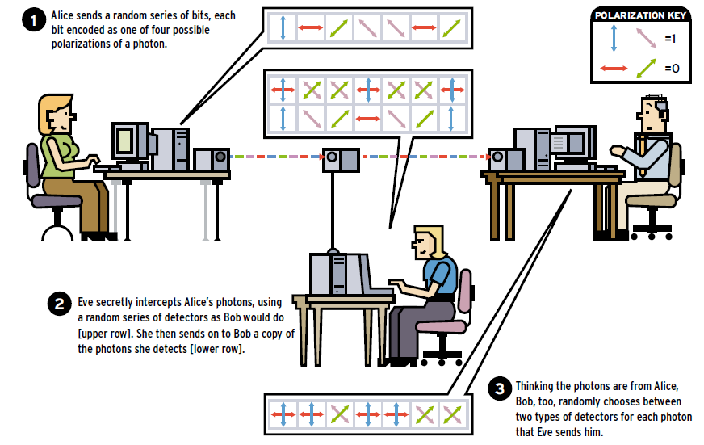

Slide 35
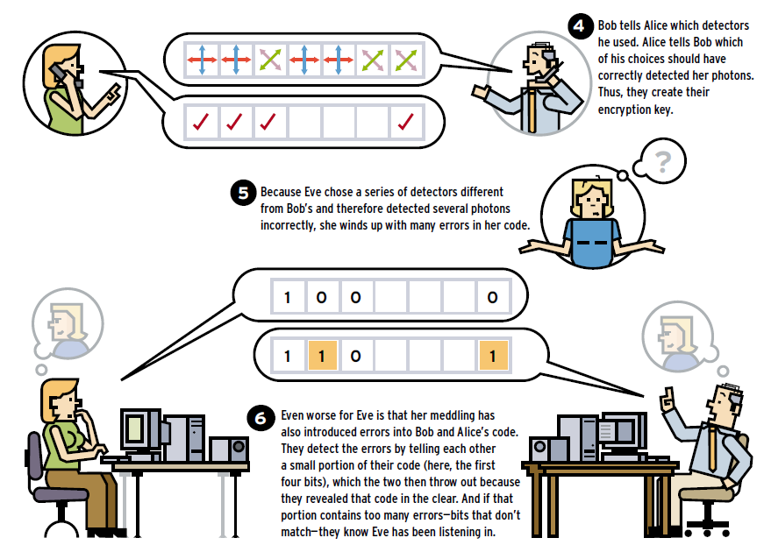

Slide 36
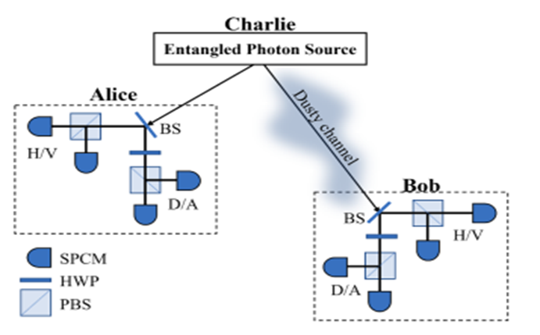
BBM92 protocol
Bennett, Brassard and Mermin proposed an entangled version of BB84 without the usage of Bell’s theorem.
Alice and Bob take photons generated from a central source.
If Alice and Bob usage the same measurement basis, then their results are perfectly correlated otherwise not.
To compensate for any secrecy loss during the basis reconciliation through classical channel, error correction (EC) and privacy amplification (PA) are performed on sifted key to get a secure key.
If Eve is trying to encode the photons, it will disturb the state of the bits. This can be seen by comparing parts of Alice’s and Bob key’s.

Slide 37
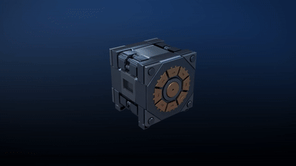

Slide 38
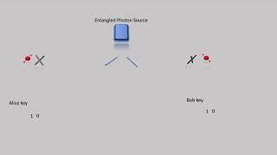

Slide 39
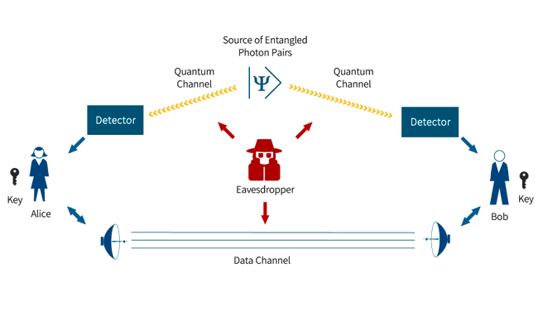

Slide 40
Thank You…!

Slide 41
Tasks - Using IBM Quantum Lab
Basic Quantum Gate implementation
Bell’s state creation / Entanglement Creation
Multi state entanglement creation
Create any quantum circuit
Create classical gate using quantum circuits
Implement BB84 protocol using IBM quantum lab

